Slide 1

Pôle gestion projet - équipe
Group 1 : Sport Track - TD1 / TP1
Matis Chabanat - Titouan Cocheril - Arthur Le Menn - Ivan Salle

Slide 2







PROBLEMS
Many applications doing the same thing but none officially affiliated to the Federation
The football license is not accessible from a phone and the license verification system is very insecure

Slide 3

SOLUTION
Several features :
Calendar
Detailed statistics
Team chat
Carpooling
Events
License scanner

Slide 4
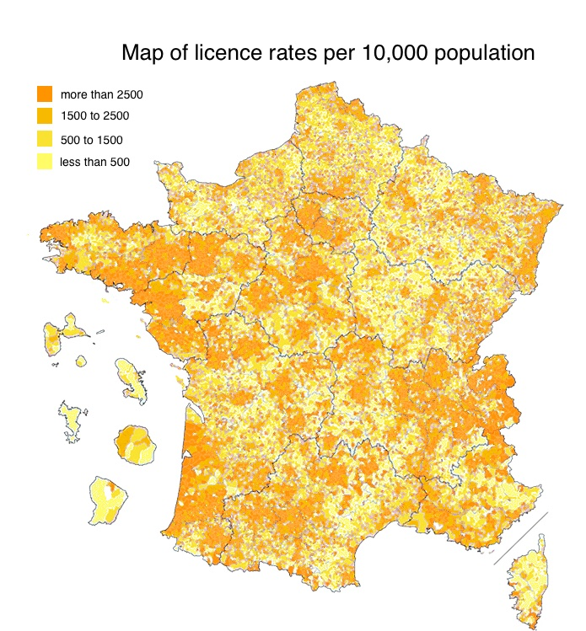

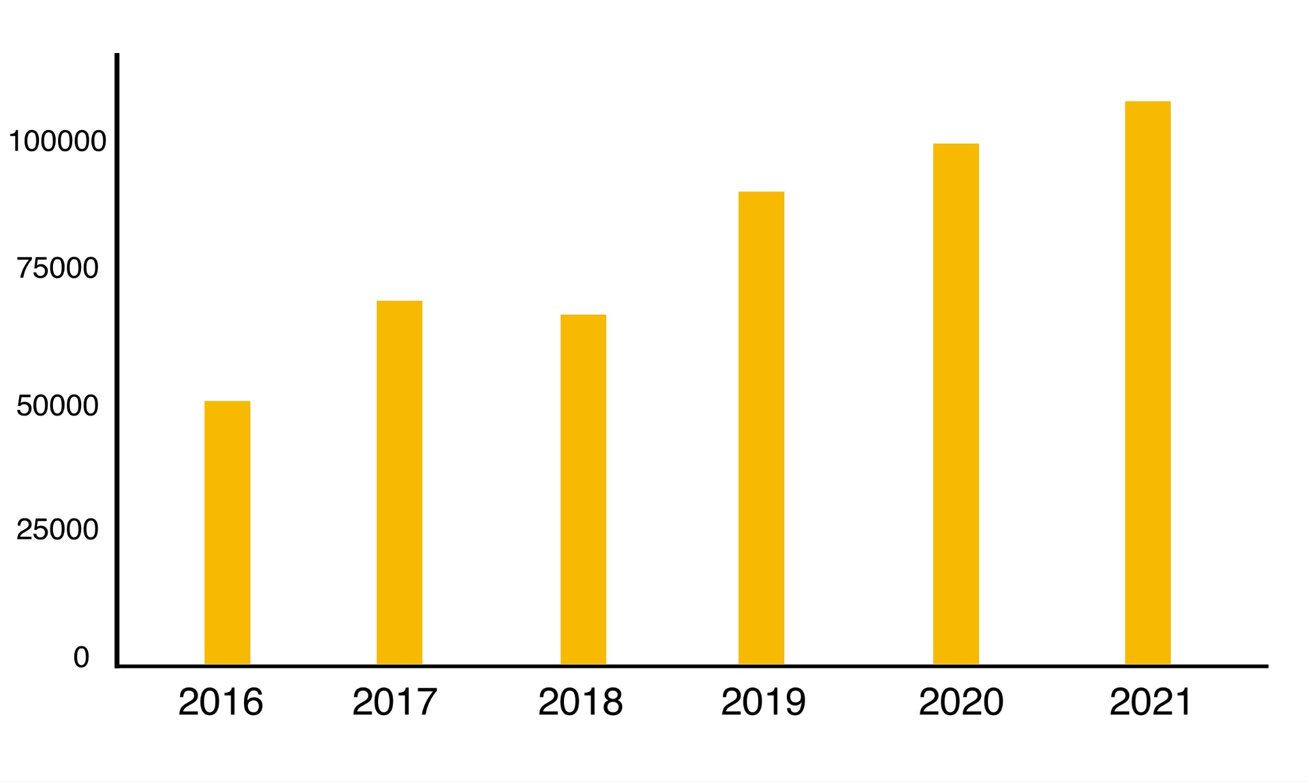
MARKET SIZE AND OPPORTUNITY
1.9 million active members
Number of sports clubs

Slide 5
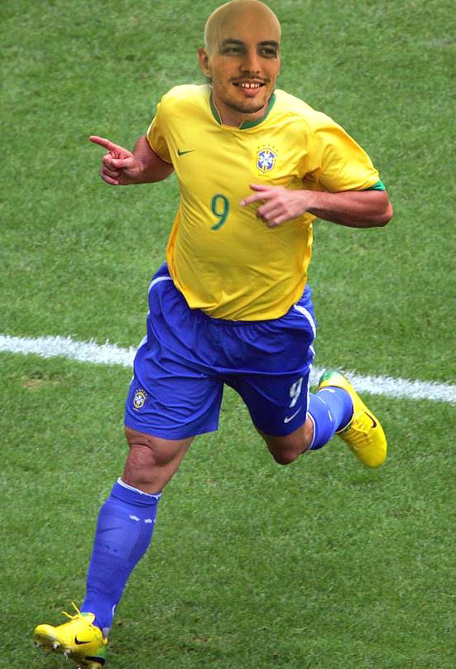
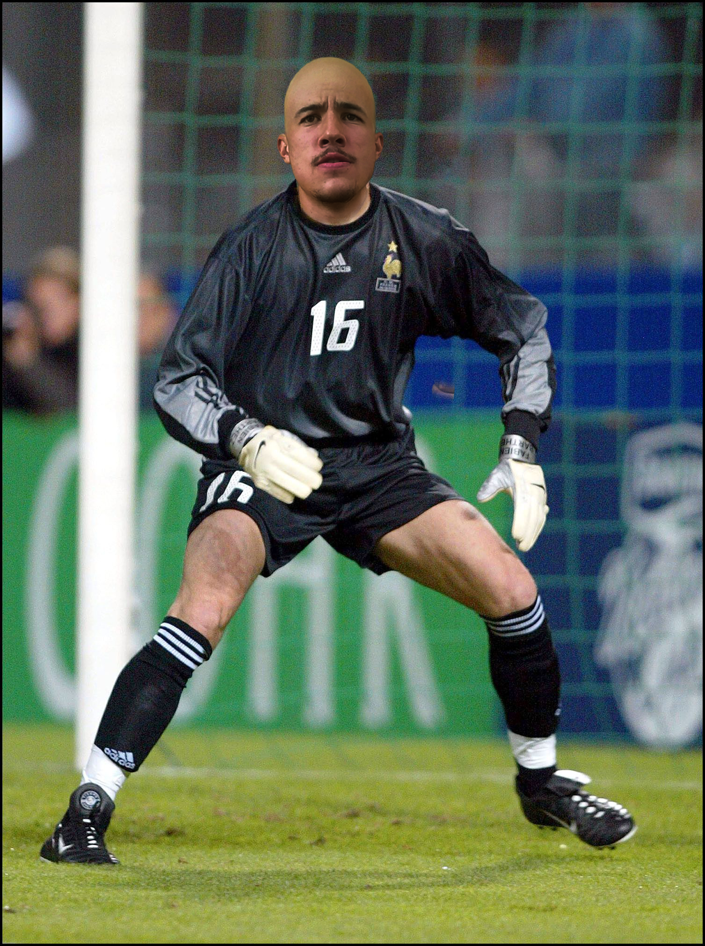
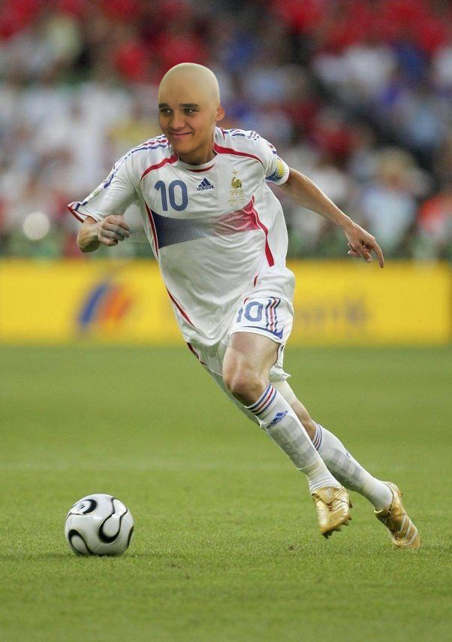
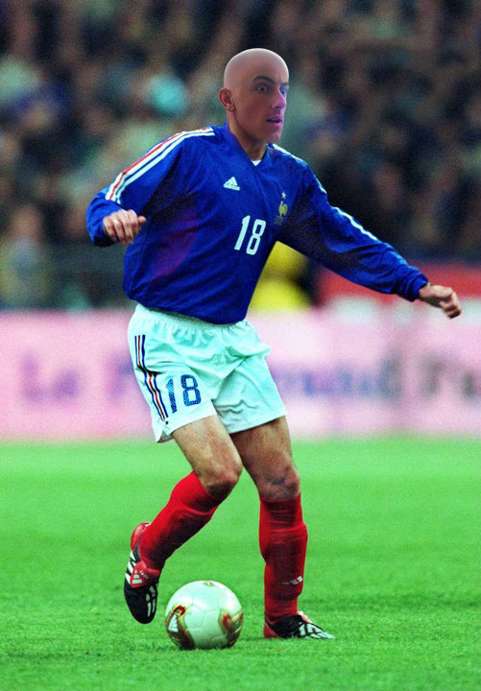
One project, four students
Core Team
Ivan Salle
Arthur Le Menn
Titouan Cocheril
Matis Chabanat
Engineer in Computer Science
Video game developer and graphist
Combines engineering and finance
Network technician and Data scientist

